Slide 1
GROUP 5
INTERNET TECHNOLOGY AND WEB DESIGN (1302 ST)
NANYANGE SUMAYAH - VU-BIT-2311-0932-DAY
MUSIIME COMFORT - VU-BIT-2311-0124-DAY
KISEMBO DEO - VU-BCS-2311-0853-DAY
KAFEERO AARON VICTOR - VU-BIT-2311-0555-DAY
MUKAMWIZA AGNES - VU-BIT-2311-0393-DAY
KISA JOHN MARK - VU-BCS-2311-0180-DAY
ABDULLAH MAHAD JAMA - VU-BIT-2201-1716-DAY
MBENGAYI BADINGA BENNY - VU-DIT-2201-0047-DAY
ABDULAHI JAMA MOHAMED - VU-BIT-2311-0519-DAY
ABDUALGADER SALIH MOHAMMED AHMED - VU-BIT-2201-1930-DAY

Slide 2
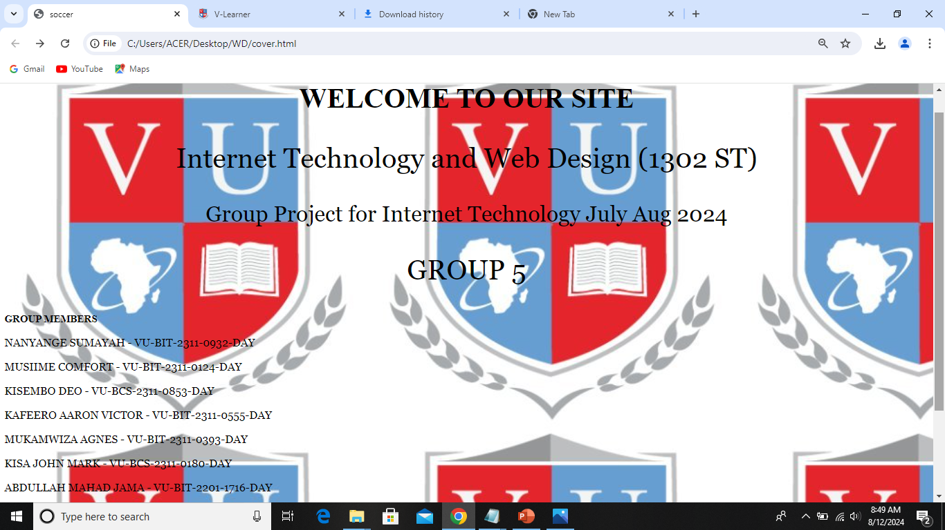
COVER PAGE

Slide 3
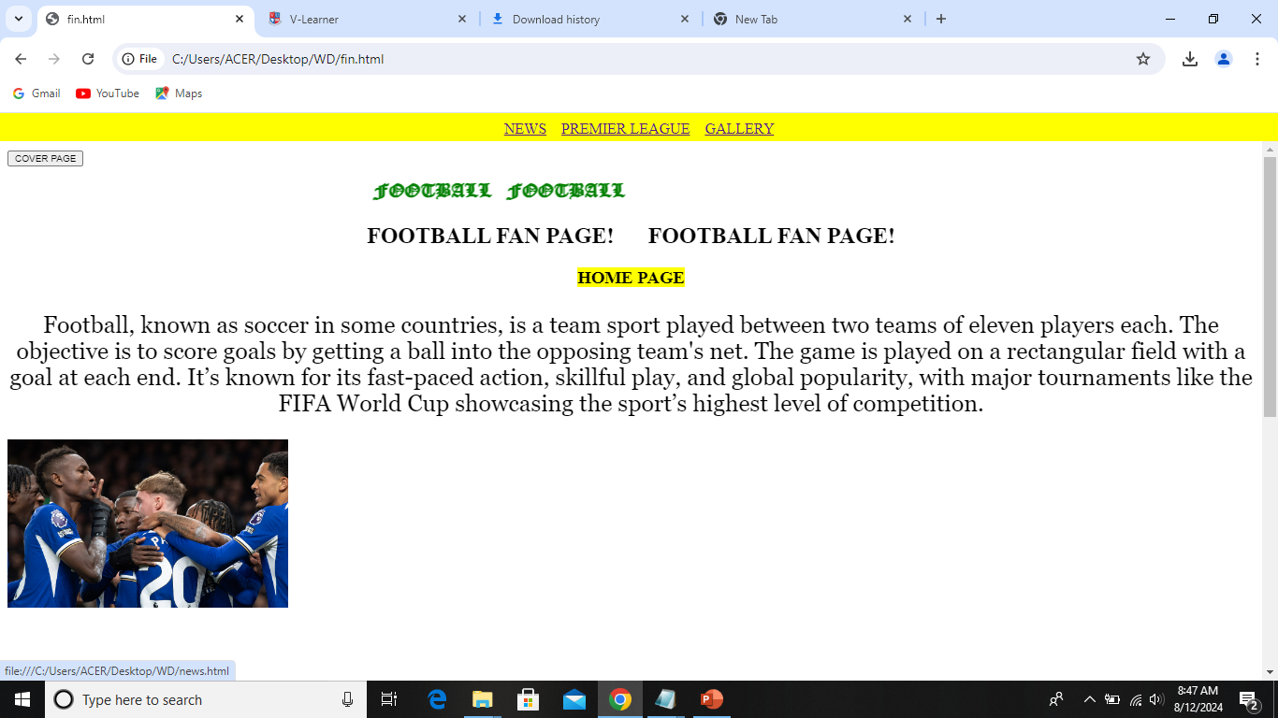
HOMEPAGE
CODE
<!DOCTYPE HTML>
<html>
<head>
<title>FIRST</title>
<style>
body {
background-color:yellow;}
</style>
<!..... THIS IS A CSS…!>
<body>
<center>
<a href="news.html" target="_top">
NEWS</a>&nbsp&nbsp&nbsp
<a href="prem.html" target="_top">PREMIER LEAGUE</a>&nbsp&nbsp&nbsp
<a href="GALLERY.html" target="_top">
GALLERY</a> </center>&nbsp&nbsp&nbsp
</body>
</html>
HOMEPAGE HTML CODE
<html>
<head>
<title></title>
</head>
<frameset rows="5%,95%" frameborder="0">
<frame src="left.html"scrolling="no">
<frame src="last.html">
</frameset>
</html>

Slide 4
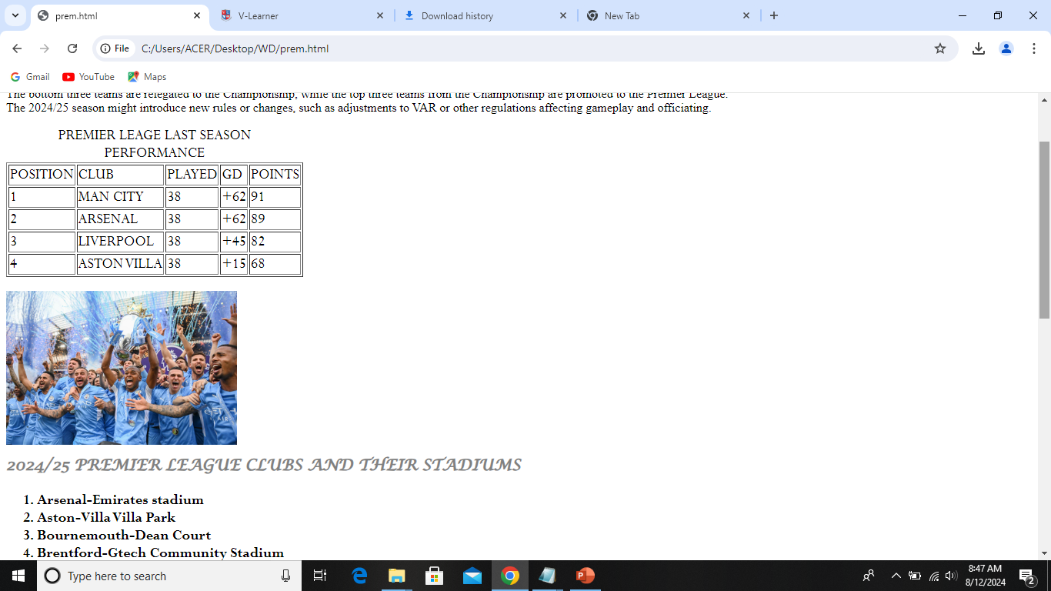
NEWS PAGE

Slide 5
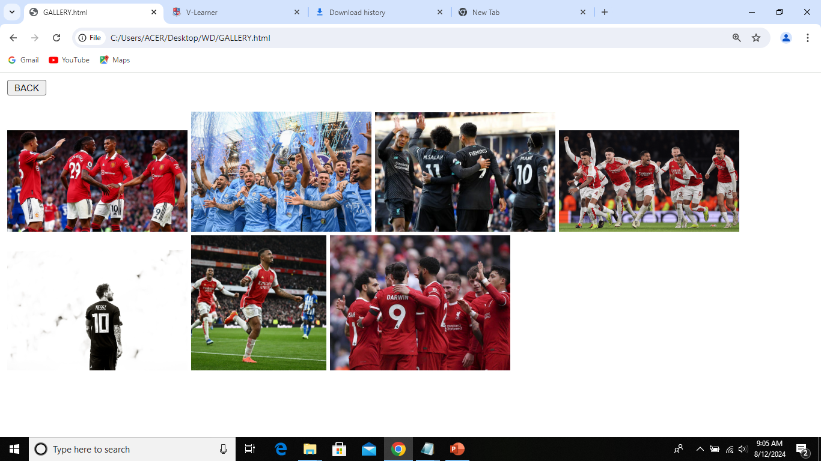
GALLERY PAGE
<style>
body {
background-color:white;}
</style>
<button style="font-size:10px"
onclick="document.location='fin.html'" target="_top">BACK</button><br><br>
<img src="mun.jpg" style="width:200px">
<img src="city.jpg" style="width:200px">
<img src="liver.jpg" style="width:200px">
<img src="imgg.png" style="width:200px">
<br>
<img src="messi.jpg" style="width:200px">
<img src="pic.jpg" style="width:150px">
<img src="pool.jpg" style="width:200px">

Slide 6
COVER PAGE CODE
<!DOCTYPE HTML>
<html>
<head>
<title>soccer</title>
<style>
body { background-image:url('logo.jpg'); background-size: 665px;}
h1 {color:white; text-align:center; }
p{ font-family:Georgia; font-size:20px; }
</style> </head>
<body>
<h2 style="text-align:center; font-size:50px">WELCOME TO OUR SITE</h2>
<p style="text-align:center; font-size:50px">Internet Technology and Web Design (1302 ST)</p>
<p style="text-align:center; font-size:40px">Group Project for Internet Technology July Aug 2024</p>
<p style="text-align:center; font-size:50px"> GROUP 5</p>
<center><button style="align:center; font-size:50px" onclick="document.location='fin.html'" target="_top">ENTER</button></center> </body> </html>

Slide 7
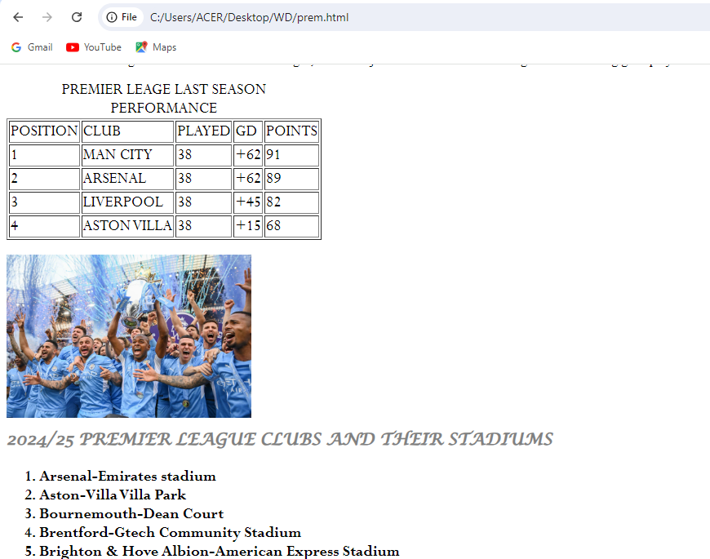
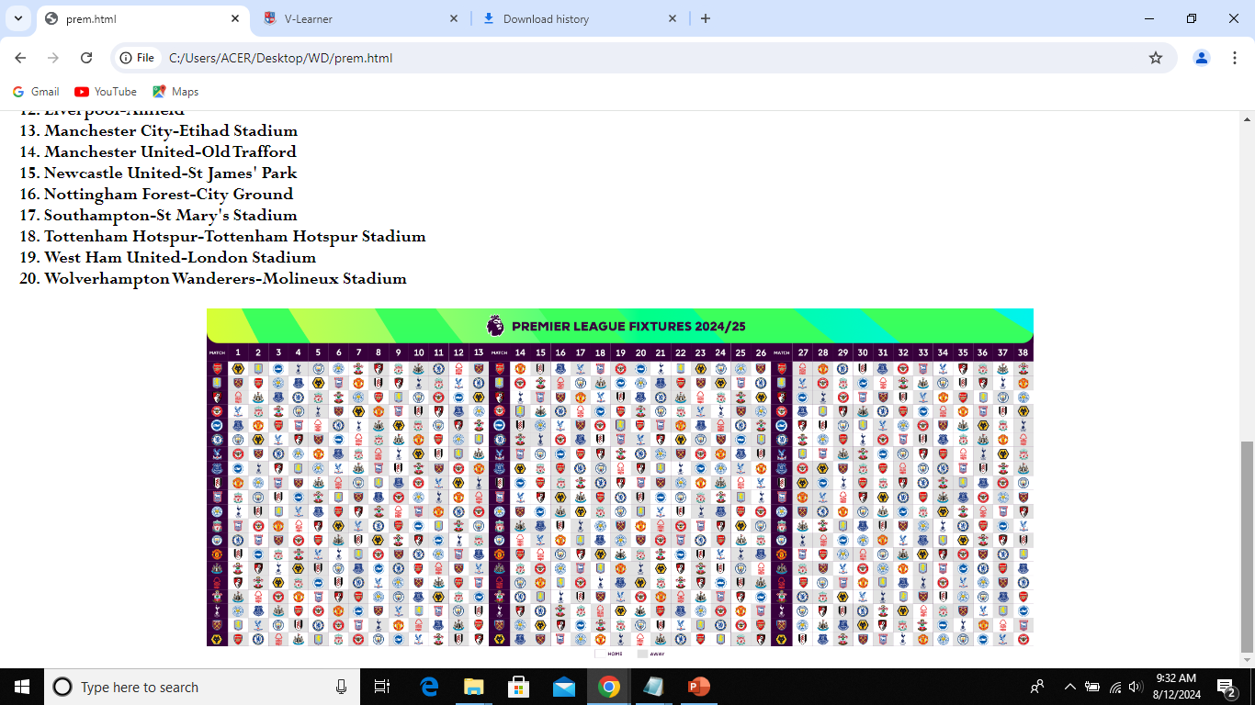
PREMIER LEAGUE PAGE

Slide 8
BODY PAGE
<!DOCTYPE HTML>
<html>
<head>
<title></title> head>
<body>
<button style=" font-size:10px" onclick="document.location='cover.html'" target="_top">COVER PAGE</button>
<h1 style="font-size:20px;font-family:old english text mt;color:green;text-align:center"><marquee>FOOTBALL&nbsp&nbsp&nbspFOOTBALL</marquee></h1>
<h2 style="text-align:center">FOOTBALL FAN PAGE!&nbsp&nbsp&nbsp&nbsp&nbsp FOOTBALL FAN PAGE!</h2>
<center><h3><mark>HOME PAGE</mark></h3>
<section> <p style="font-size:25px; font-family:georgia;color:black">Football, known as soccer in some countries,
is a team sport played between two teams of eleven players each.
The objective is to score goals by getting a ball into the opposing team's net.
The game is played on a rectangular field with a goal at each end.
It’s known for its fast-paced action, skillful play, and global popularity,
with major tournaments like the FIFA World Cup showcasing the sport’s highest level of competition.</section></center>
<img src="chl.jpg" style="width:300px">
<br><br><br> <p style="font-size:25px; font-family:constantia;color:black">
<mark>HISTORY</mark></p>
<p> <dl style="font-size:15px; font-family:constantia;color:black">

Slide 9
CONTINUATION
<dt>ARSENAL 1886</dt>
<dd>started by Scotsman david and 15 workers in Woolwich named after a workshop of the royal Arsenal comples<br>It achieved success in the early 20th century,
winning their first league title in 1991.
Under manager Herbert Chapman in the 1920s and 1930s<br>
Arsenal became one of the dominant teams in English football, securing multiple league titles and FA Cups
(13* LEAGUE CHAMPIONS 14* FA CUP WINNERS 2*LEAGUE CUP WINNERS).<br>
From 1996 to 2018, manager Arsène Wenger led Arsenal to numerous trophies, including three Premier League titles and seven FA Cups.<br>
Notably, Arsenal went the entire 2003-04 Premier League season unbeaten, earning the nickname "The Invincibles."<br>
Recent Years: The club has continued to compete in the Premier League and European competitions, with a focus on rebuilding and achieving new successes
</dd>
<dt>MANCHESTER UNITED 1878</dt>
<dd>started as Newton Health LYR football cub till 1902<br>It won it's first league title in 1908 and their first FA Cup in 1948.<br>
Under manager Matt Busby in the 1950s. In 1968, Manchester United won the European Cup, becoming the first English club to achieve this feat.<br>
Sir Alex Ferguson, who managed the club from 1986 to 2013, led United to numerous domestic and international successes,
including 13 Premier League titles and 2 UEFA Champions League trophies.
</dd>
</dl></p>
<a href="http://www.youtube.com/@footmood">Click for youtube matches.</a><br><br>
<img src="mun.jpg" style="width:400px">
<img src="city.jpg" style="width:300px">
<img src="imgg.png" style="width:300px"></center>
</body>
</html>

